Slide 1
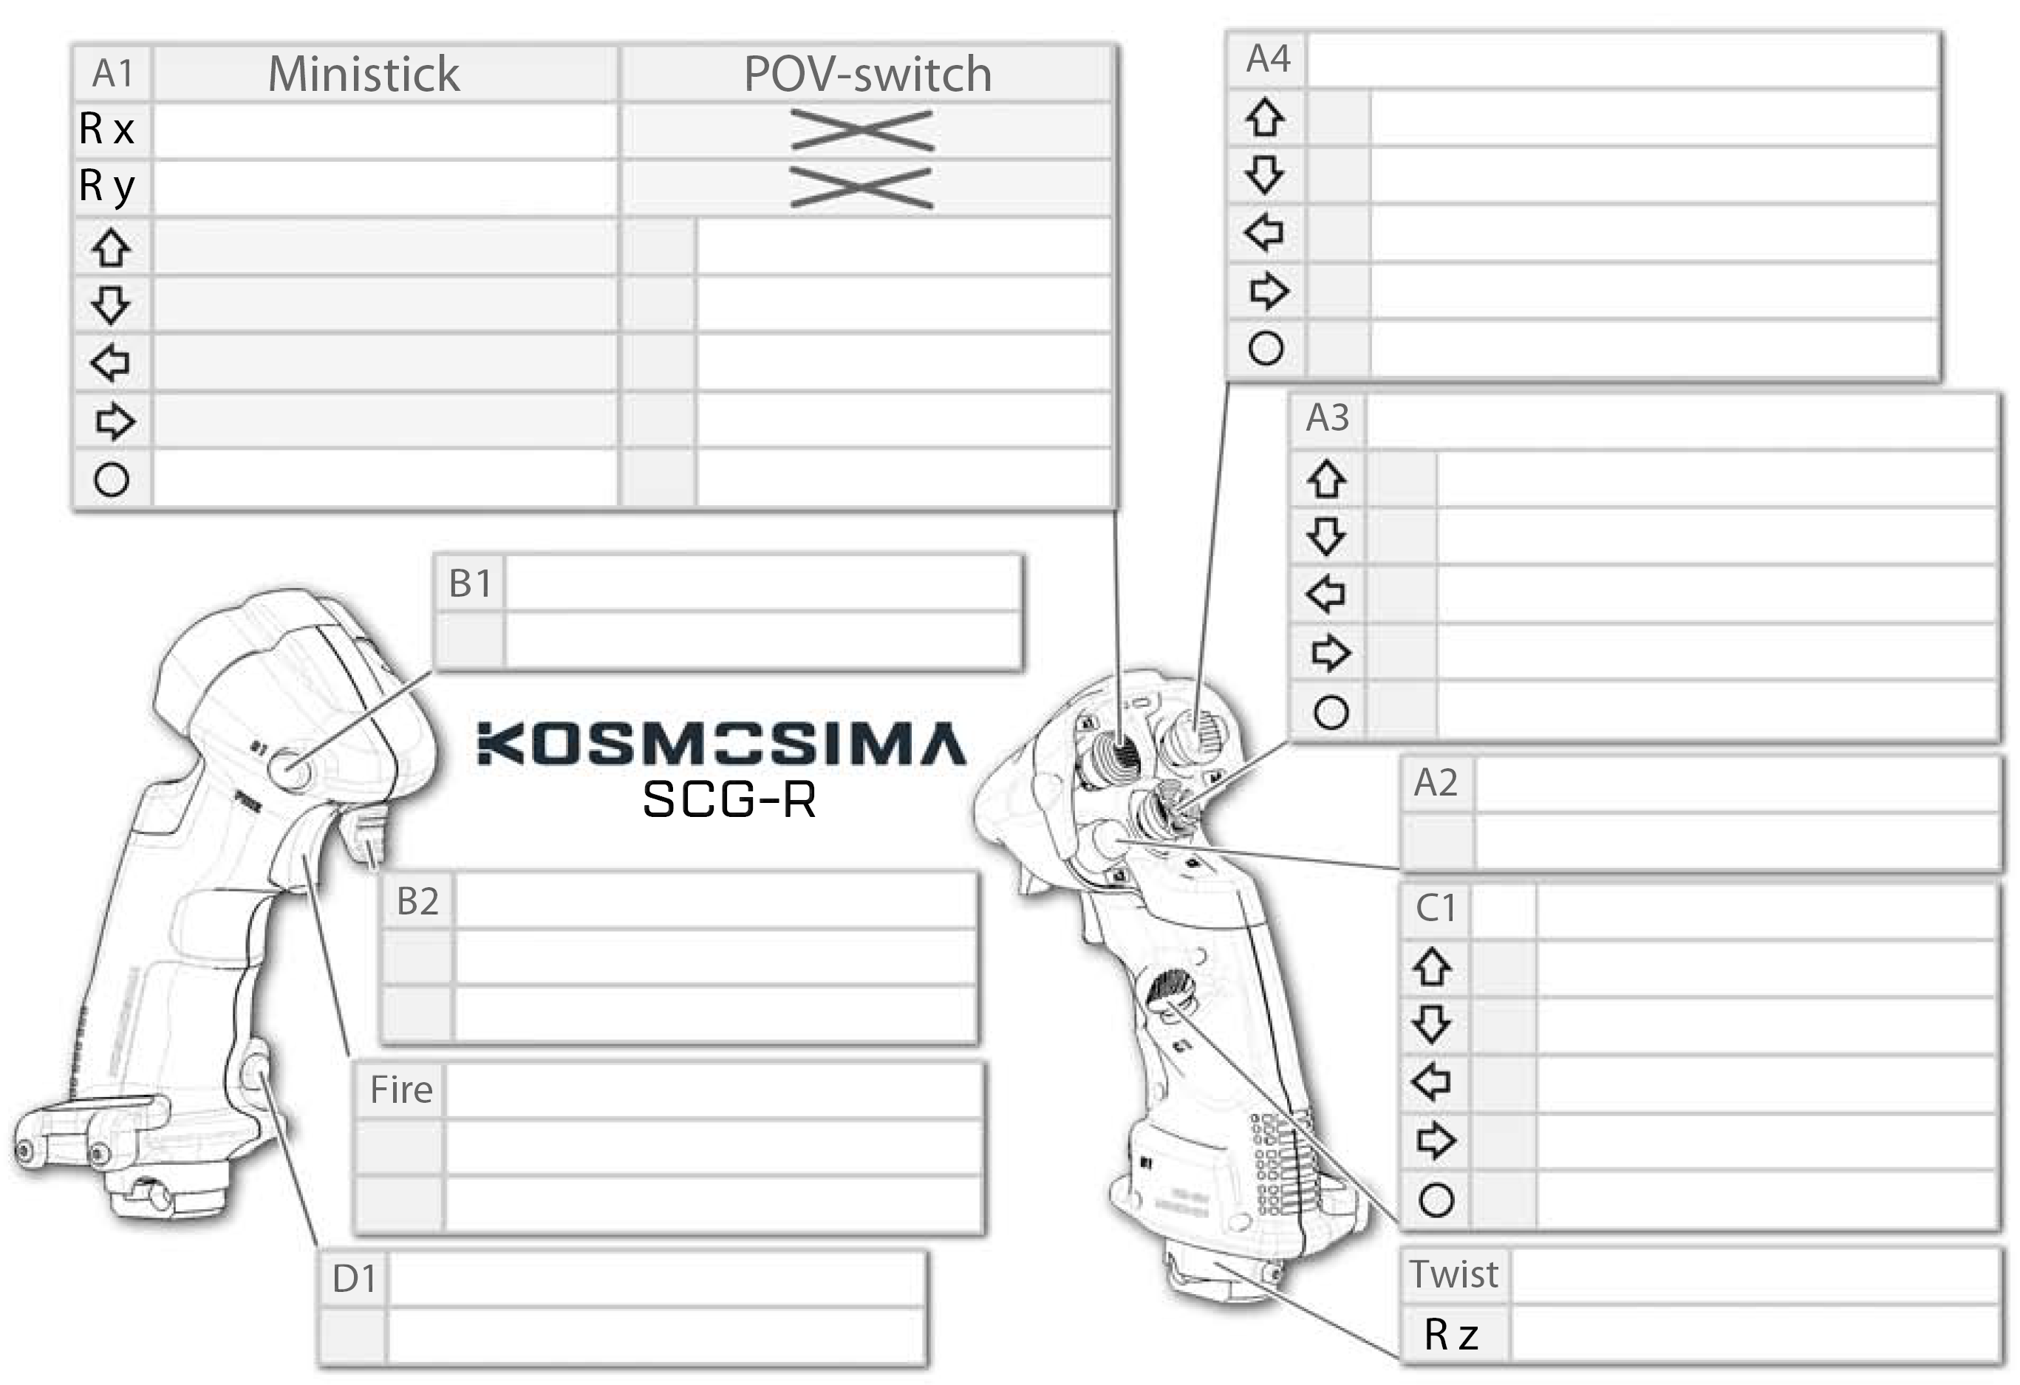

Red Light On
No Light On
Trim Adjustment Switch
Move Stick Left/Right
6
Move Stick Up/Down
8
POV⬆
9
POV⬇
7
POV⬅
10
POV➡
Castle Switch
Change to POV-switch Mode 👉🏻
👈🏻 Change to Ministick Mode
11
13
Index Finger Button
14
4
12
Base / Gimbal
Lx / Ax (Lean Stick Left/Right)
Ly / Ay (Lean Stick Forward/Backward)
15
“Pickle Button”
3
Secondary Trigger
Lower Thumb Button
Forward
26
Forward
23
Backward
27
Backward
21
Primary Trigger
24
In
1
22
In+
2
25
Pinkie Button
5
Notes:
A2 is called “the pickle button” and is conventionally used for weapons employment
A3 is conventionally-used for interaction with displays (up/down/left/right/select UI navigation)
A4 is conventionally-used for trim adjustments

